Slide 1


Project – Introduction to Part 3
Lecture ME 454
Modeling and Optimization of Energy Systems
Prof. F. Maréchal
Eduardo Pina, Sai Ravi, Michele Poli
École Polytechnique Fédérale de Lausanne
2025

Slide 2
Project – Part 3
2
Giulia Giacomini
Provide decision support to EPFL to choose a working fluid for the novel centralized heating system composed of a two-stage HP with maximum capacity of 6 MW based on environmental and economic characteristics.
Tasks:
Build a thermodynamic model of the two-stage HP in the process simulation software Belsim VALI
Use measurement data for performing Degrees of Freedom (DoF) and data
reconciliation analyses
Use the results of the data reconciliation to evaluate the thermodynamic and economic performances of the system
Project ME 454 – Introduction to Part 3

Slide 3
Modelling of a simple heat pump – Optional
3
Giulia Giacomini
Tutorials on SwitchTube
Vali Tutorial
  Opening Vali
  Creating a first PFD
  Defining Thermods
Heat pump compressions
  Creating streams
    Material
    Mechanical
Defining units
  Compressor
3. DoF analysis and running
Heat pump remaining steps
  Defining units
    Heat exchanger
    Valves
  Defining streams
    Thermal
Closing loops
  Defining units
    Cutval
  Debugging
    Error reporting
    DOF reporting
Running
Project ME 454 – Introduction to Part 3
iii.

Slide 4
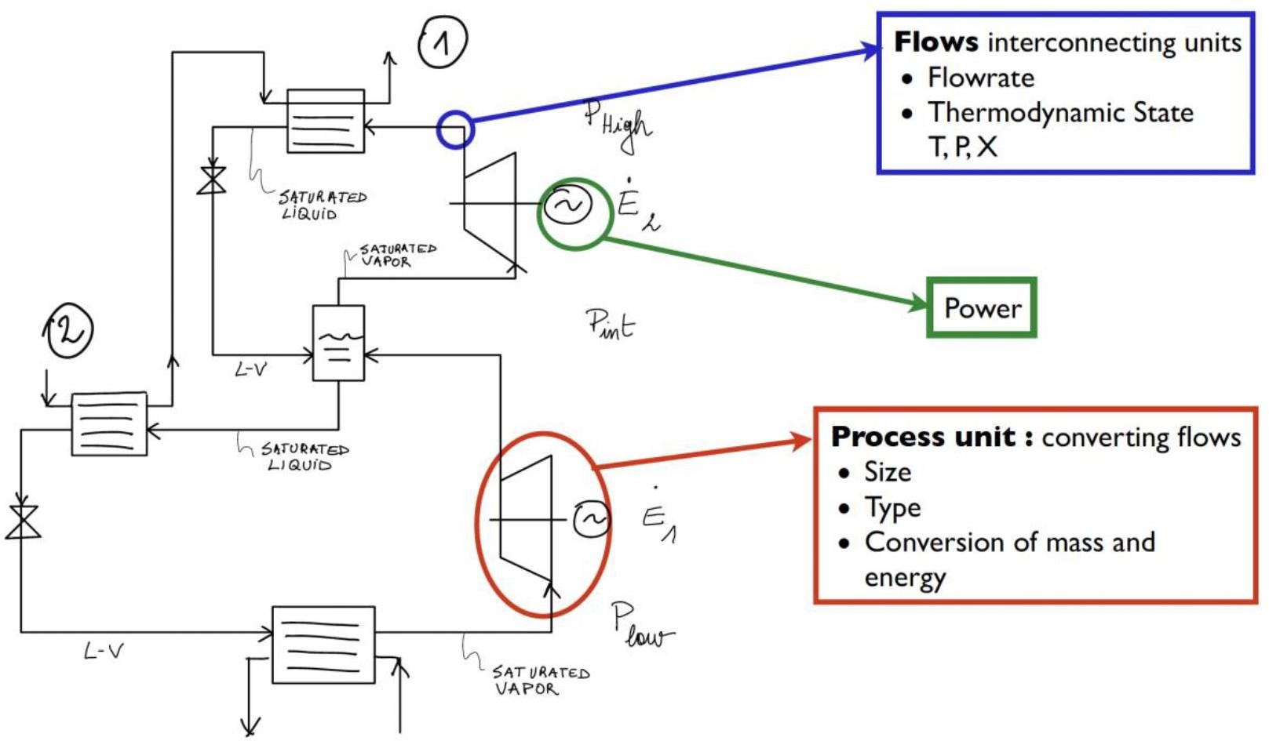
Modelling of a two-stage HP – Flowsheet
4
Giulia Giacomini
Project ME 454 – Introduction to Part 3

Slide 5
Belsim VALI
5
Giulia Giacomini
Flowsheeting and data reconciliation tool:
Equation-based data validation and reconciliation (DVR) software, respecting energy and mass balances
Uses information redundancy and conservation laws to correct
measurements and convert them into accurate and reliable information
Used in upstream, refinery, petrochemical and chemical plants as well as power plants, including nuclear power stations
Project ME 454 – Introduction to Part 3

Slide 6
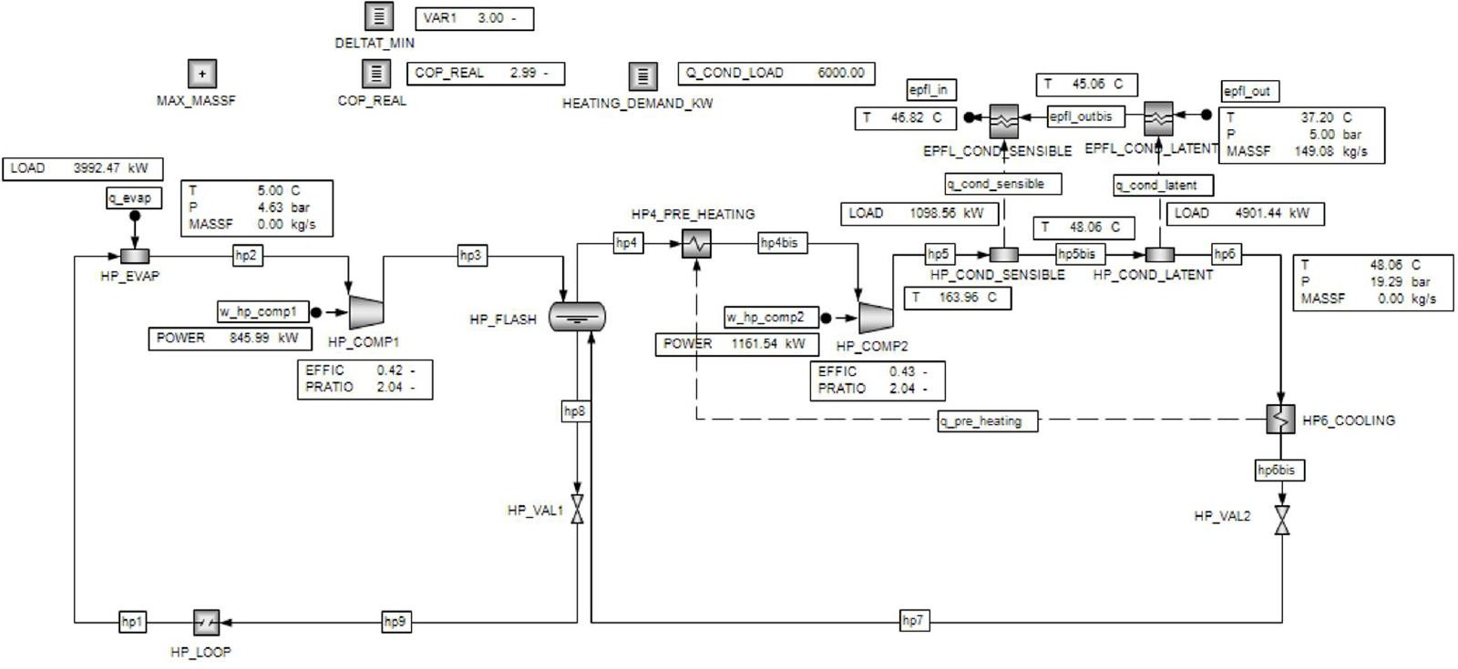
Modelling of a two-stage HP – Belsim VALI
6
Giulia Giacomini
Project ME 454 – Introduction to Part 3

Slide 7
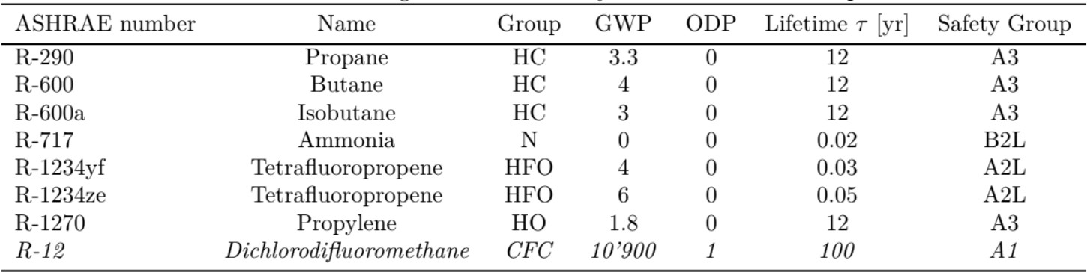
Working Fluids
7
Giulia Giacomini
All the steps described next need to be carried out for the R-290 and another working fluid of choice
→ Remember to use the corresponding Vali model!
Justify your choice considering thermophysical and economic features, safety concerns, environmental impact, and other properties you judge relevant
Project ME 454 – Introduction to Part 3

Slide 8
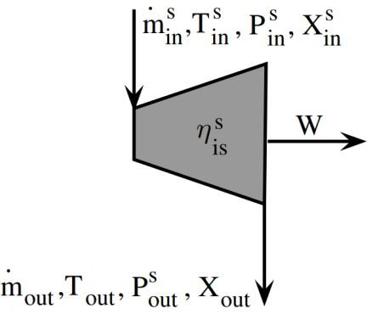
DoF Analysis – Flowsheet
8
Giulia Giacomini
Degrees of Freedom: 𝑛_{𝐷𝑜𝐹} = 𝑛_{𝑣𝑎𝑟𝑖𝑎𝑏𝑙𝑒𝑠} − 𝑛_{𝑒𝑞𝑢𝑎𝑡𝑖𝑜𝑛𝑠}
e.g. Compressor unit
^{𝑛}𝑣𝑎𝑟𝑖𝑎𝑏𝑙𝑒𝑠 ⁼ ¹⁴
^{𝑛}𝑒𝑞𝑢𝑎𝑡𝑖𝑜𝑛𝑠 ⁼ ⁹
Mass balance - 𝑚ሶ _{𝑜𝑢𝑡} − 𝑚ሶ ^{𝑠} = 0
𝑖𝑛
Enthalpy of the input - ℎ_{𝑖𝑛} − ℎ(𝑇^{𝑠} , 𝑃^{𝑠} , 𝑋^{𝑠} ) = 0
𝑖𝑛 𝑖𝑛 𝑖𝑛
Entropy of the input - 𝑠_{𝑖𝑛} − 𝑠(𝑇^{𝑠} , 𝑃^{𝑠} , 𝑋^{𝑠} ) = 0
Project ME 454 – Introduction to Part 3
𝑖𝑛 𝑖𝑛 𝑖𝑛
…
𝑛_{𝐷𝑜𝐹} = 5
The DoF analysis needs to be carried out for the process flowsheet of the whole two−stage heat pump

Slide 9
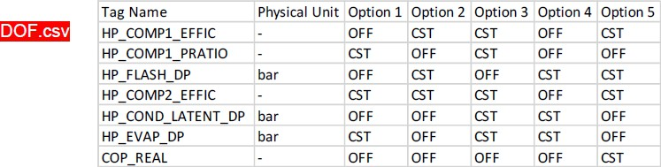
DoF Analysis – Excel Sheet
9
Giulia Giacomini
Perform the DoF analysis of the model of the two-stage heat pump
Evaluate which of the 5 options in the Excel file is the right one:
  OFF = feeding the model with a constant value of these variables would lead to overspecification
  CST = specifications to be provided to solve the model
Open one of the R-XXX_empty.bls file in Vali and activate the necessary TAGS
→ Do not change any values but just change the accuracy tab from OFF to CST
Run the model and hope for convergence
Don’t forget to activate the Edit Mode!
Project ME 454 – Introduction to Part 3

Slide 10
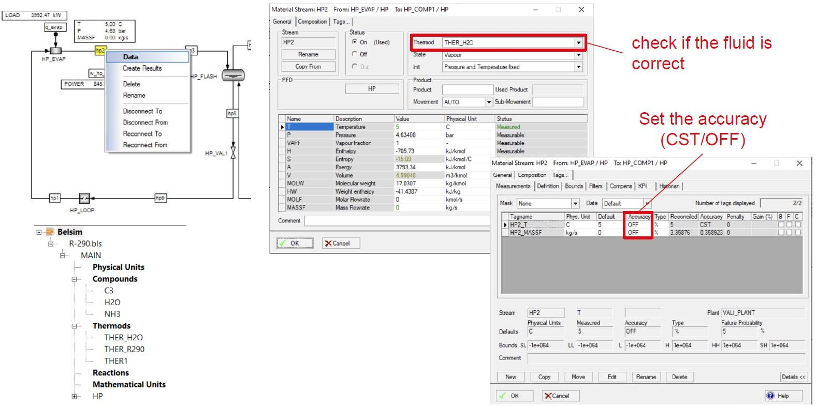
DoF Analysis – Belsim VALI
10
Giulia Giacomini
Project ME 454 – Introduction to Part 3

Slide 11
Data reconciliation
11
Giulia Giacomini
Measured data contains inconsistencies:
  Random errors → sensor location, plant instabilities, measurements taken at different times, etc.
  Systematic errors → sensor calibration, measurement bias, intrinsic sensor precision, etc.
→ Data reconciliation ensures that there are no violations of mass and energy conservation laws
Data reconciliation relies on measurement redundancy
→ The measured values of the variables that are not set as specifications for the resolution of the model are redundant
The data reconciliation problem statement minimizes the error between the
measured values and the validated one
→ Validated values solve the system model equations
Project ME 454 – Introduction to Part 3

Slide 12
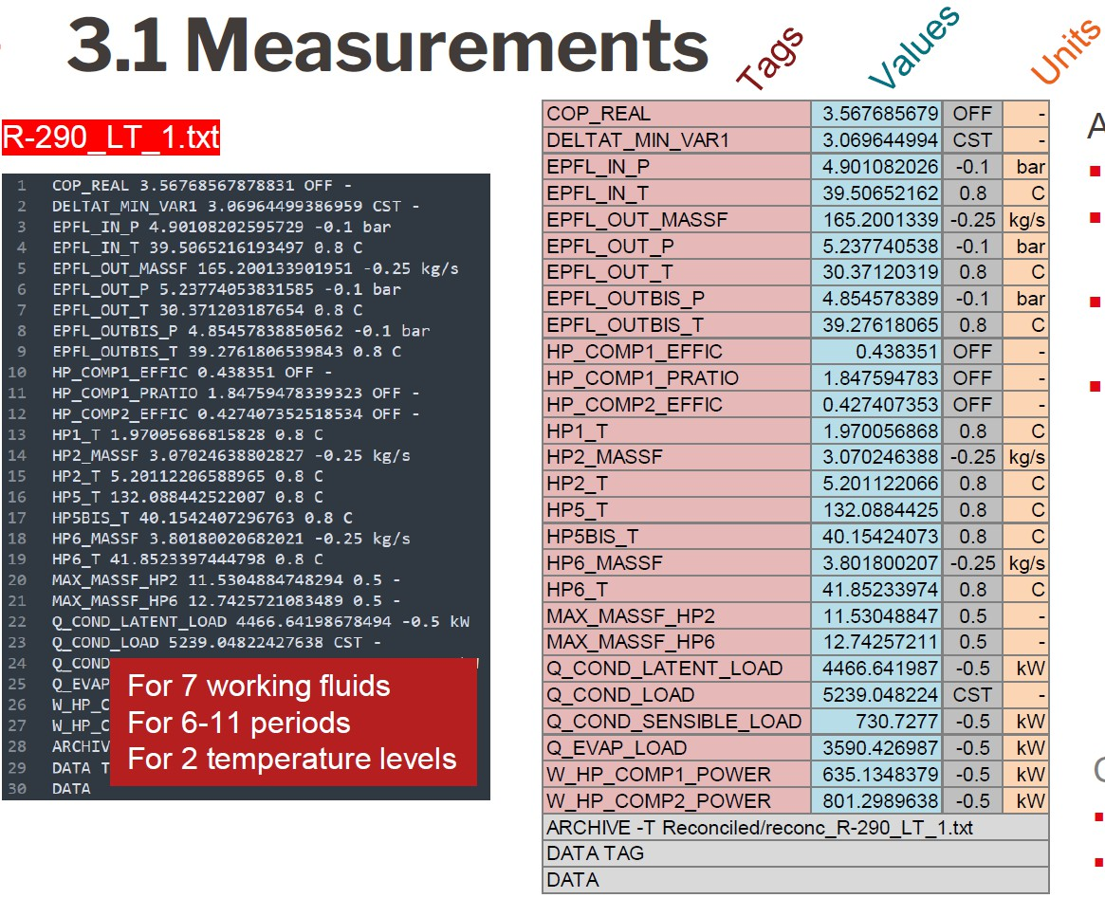
Data reconciliation – Measurements
12
Giulia Giacomini
Project ME 454 – Introduction to Part 3

Slide 13
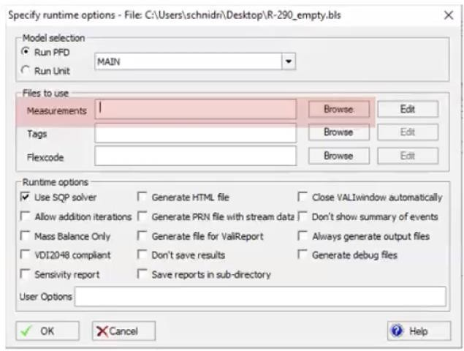
Data reconciliation – Belsim Vali
13
Giulia Giacomini
With the calibrated model:
Upload the measurement file
Run the model to perform data reconciliation
→ Make sure to have a folder named “Reconciled” in the same folder as your Vali model!
  If converged: you can proceed with next measurement
  If not converged: you should re-run the model without measurements, then re-run it with the previous measurements, load the results and finally re-run with the current measurement file
Project ME 454 – Introduction to Part 3

Slide 14
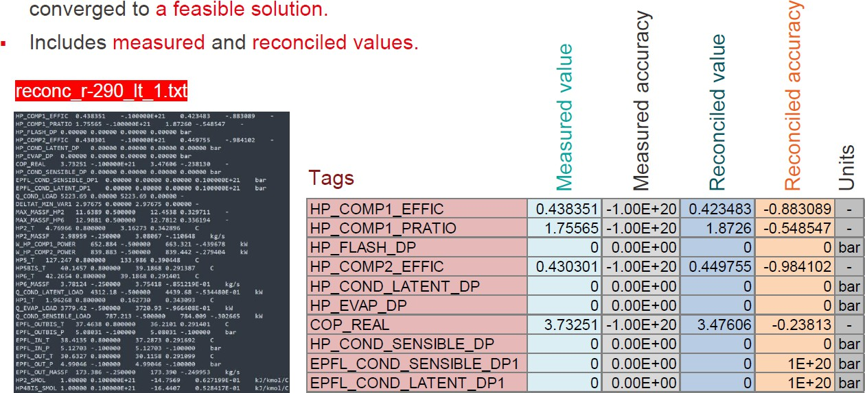
Data reconciliation – Results
14
Giulia Giacomini
The output file is generated if Vali has converged to a feasible solution
→ It includes both measured and reconciled values
Project ME 454 – Introduction to Part 3

Slide 15




Performance evaluation – Thermodynamics
15
Giulia Giacomini
Using the reconciled data:
Derive a polynomial function of the Carnot factor as a function of the ambient temperature for both stages of the heat pump
  𝐶∗ 𝑡 = 𝑎 ⋅ 𝑇² − 𝑏 ⋅ 𝑇 + 𝑐
𝐶𝑎𝑟𝑛𝑜𝑡 𝑎𝑚𝑏 𝑎𝑚𝑏
2. Minimize the mean square error between the Carnot factor calculated with the given operating conditions and the Carnot factor calculated with the polynomial function over all measurement sets
₌ 𝑄𝑐𝑜𝑛𝑑 𝑡 ⋅ ^{𝑇}𝑐𝑜𝑛𝑑 ^{𝑡 −𝑇}𝑒𝑣𝑎𝑝 ^{𝑡}
^{𝐶}𝐶𝑎𝑟𝑛𝑜𝑡 ^{𝑡}
𝑇_{𝑐𝑜𝑛𝑑}(𝑡)
2
Project ME 454 – Introduction to Part 3
𝑊_{𝑡𝑜𝑡}(𝑡)
min σ
_{𝐶}∗
𝑡 − 𝐶 𝑡
𝑎,𝑏,𝑐
𝑡 𝐶𝑎𝑟𝑛𝑜𝑡 𝐶𝑎𝑟𝑛𝑜𝑡
3. Calculate the Carnot factor for the temperatures of the clusters and plot the
Carnot factor vs ambient temperature

Slide 16
Performance evaluation – Economics
16
Giulia Giacomini
Using the reconciled data:
Size the heat exchangers and compressors for the worst case, i.e. highest heat
demand, present in the measurement set
Calculate the specific capital cost of the heat pump considering compressors and heat exchangers
  Use reconciled data for different working fluids to compare the thermodynamic and economic performances of the system in each case
Project ME 454 – Introduction to Part 3

Slide 17
Deliverables – Part 3
17
Giulia Giacomini
For the different working fluids:
Size of the heat exchangers and compressors
Total cost of the system including the investment cost of the heat exchangers
and compressors
→ Provide decision support to EPFL to choose the working fluid for the two-stage HP
Unit cost of the system per kW of heat pump capacity installed
Carnot factor as a polynomial function of the ambient temperature 𝑇_{𝑒𝑥𝑡}
→ Information to be used in Part 4
Project ME 454 – Introduction to Part 3

Slide 18
18
Speaker
Appendix –
Belsim VALI
NAME EVENT / NAME PRESENTATION

Slide 19
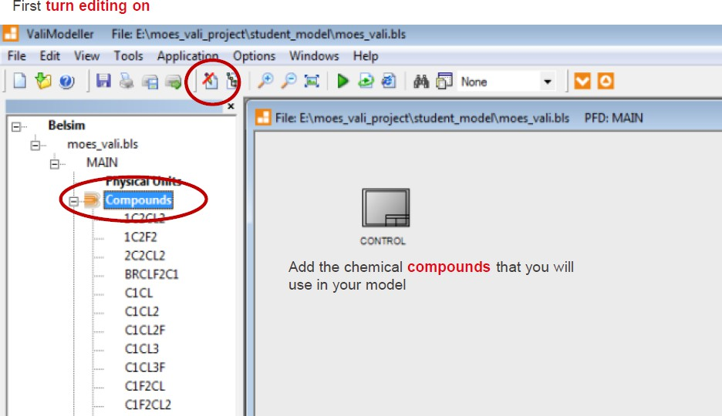
Vali modelling basics
19
Giulia Giacomini
Project ME 454 – Introduction to Part 3

Slide 20
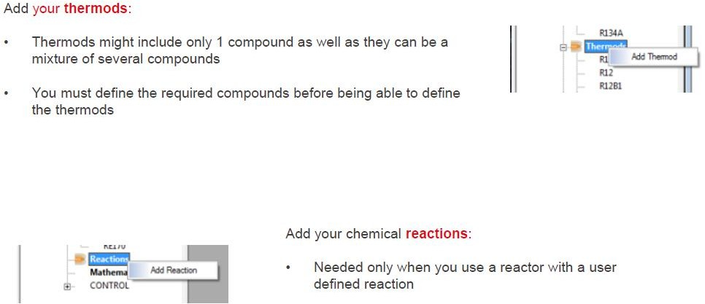
Vali modelling basics
20
Giulia Giacomini
Project ME 454 – Introduction to Part 3

Slide 21
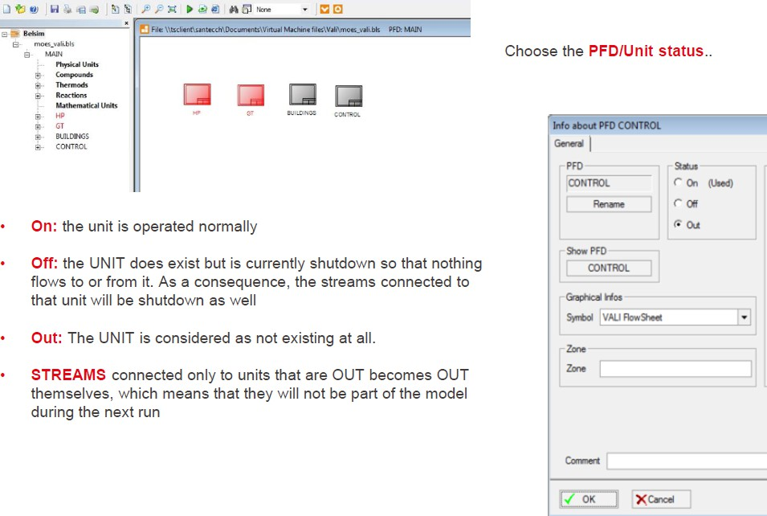
Vali modelling basics
21
Giulia Giacomini
Project ME 454 – Introduction to Part 3

Slide 22
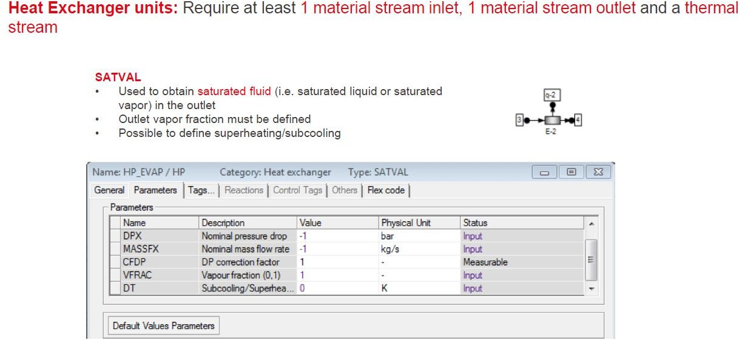
Commonly used Vali units
22
Giulia Giacomini
Project ME 454 – Introduction to Part 3

Slide 23
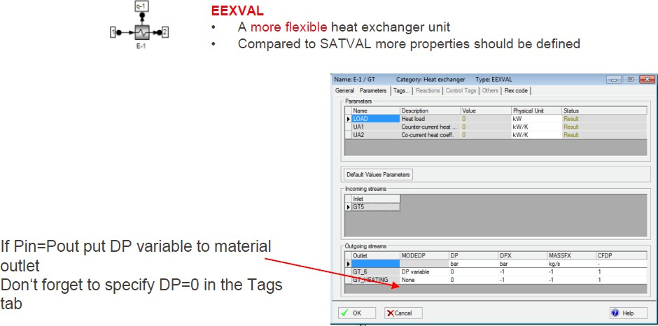
Commonly used Vali units
23
Giulia Giacomini
Project ME 454 – Introduction to Part 3

Slide 24
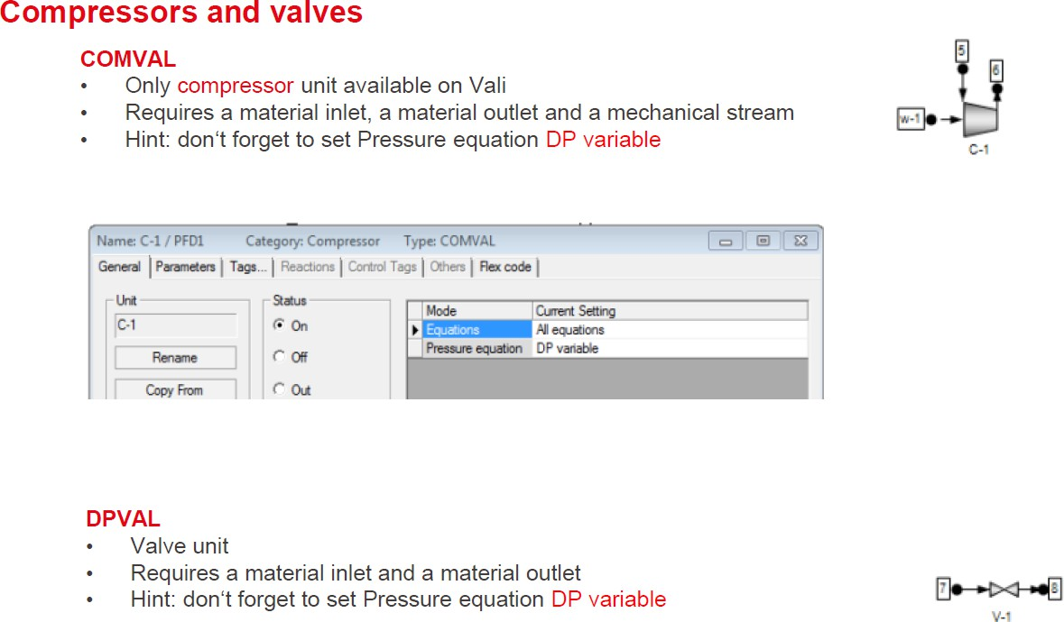
Commonly used Vali units
24
Giulia Giacomini
Project ME 454 – Introduction to Part 3

Slide 25
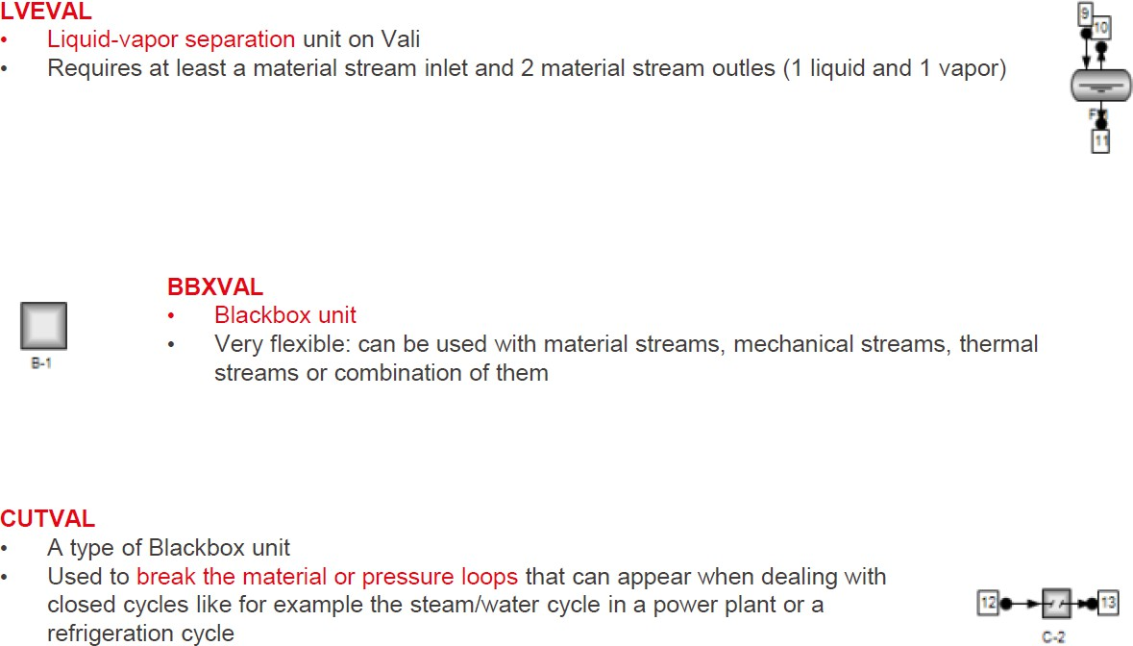
Commonly used Vali units
25
Giulia Giacomini
Project ME 454 – Introduction to Part 3

Slide 26
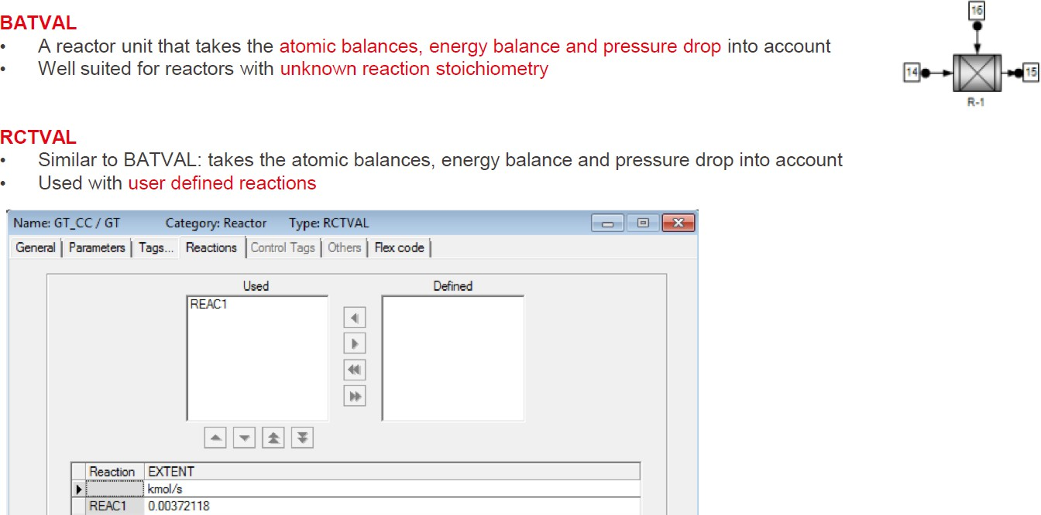
Commonly used Vali units
26
Giulia Giacomini
Project ME 454 – Introduction to Part 3

Slide 27
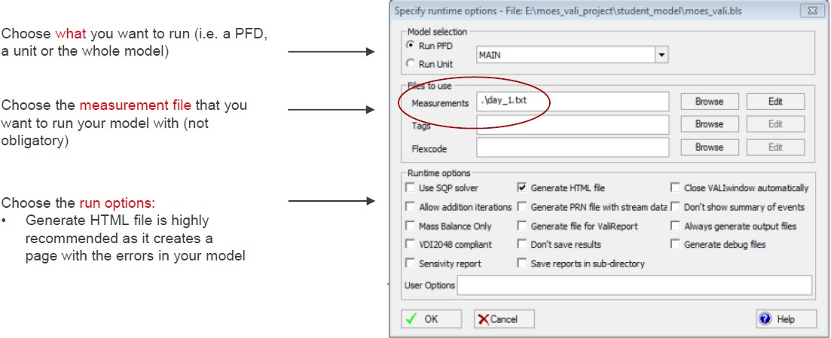
How to run a Vali model
27
Giulia Giacomini
Project ME 454 – Introduction to Part 3

Slide 28
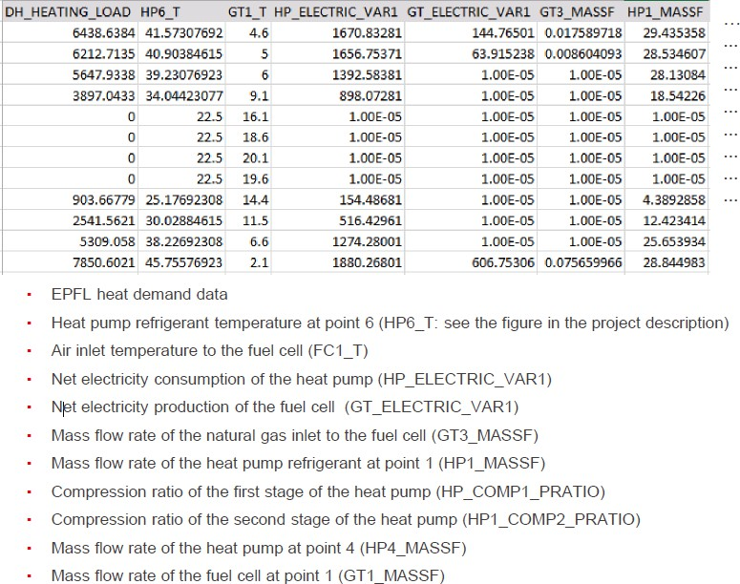
Vali input file – Measurements
28
Giulia Giacomini
Project ME 454 – Introduction to Part 3

Slide 29
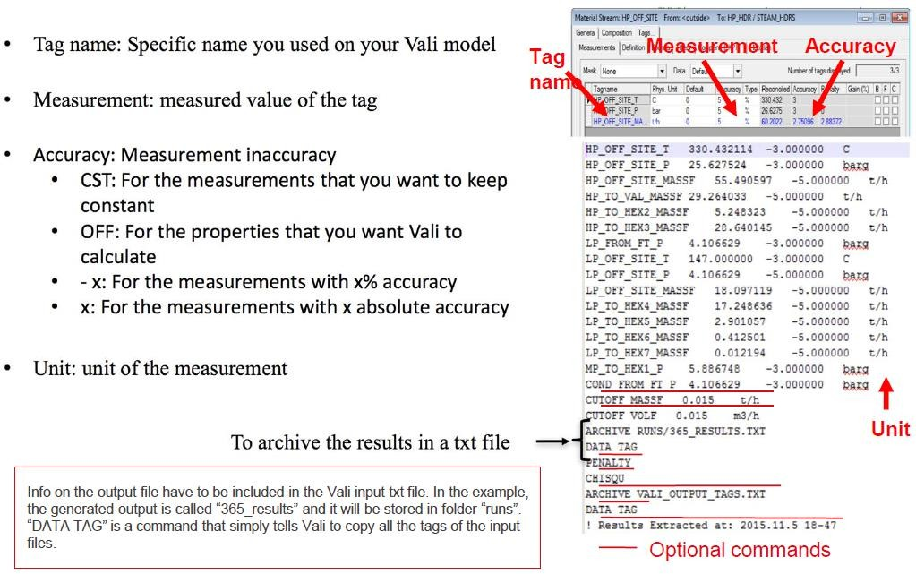
Vali input file – Measurements
29
Giulia Giacomini
Project ME 454 – Introduction to Part 3

